Slide 1
Engine Controller
Team 513

Slide 2




Team 513
Patrick Marlatt
Project
Engineer
Fred Peterson
Software Engineer
Austin LaFever
Lead Controls Engineer
Jonathan Wozny
Fluids and Test Engineer
Patrick Marlatt

Slide 3
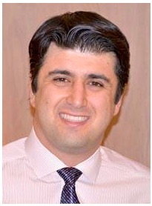
Sponsors and Advisor
Engineering Mentor
Roberto Valenti
Project Advisor
Engineering Mentor
Peter Maloney
Controls Advisor
Academic Advisor
Dr. Shoele, Ph.D.
Assistant Professor
Patrick Marlatt

Slide 4
Objective
The goal of this project is to create and implement a multi-input multi-output control system for airflow components in the Mathworks Powertrain Blockset.
Patrick Marlatt

Slide 5



Motivation
Internal combustion engines will be prevalent for the foreseeable future
Modernize Mathworks' engine control unit for Powertrain Blockset engine simulation with multi-input/multi-output controller
Improve torque-tracking in engine dynamometer simulation
Patrick Marlatt
Notes:
We are starting the process of modernizing their engine control unit with multi-input multi-output → their control setup is pretty outdated and used only single input single output
Will need to explain what a dynamometer is.

Slide 6
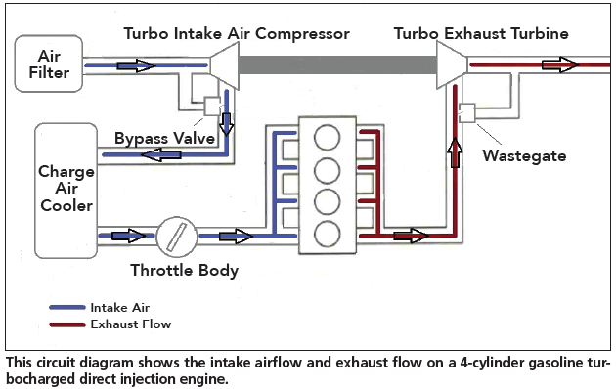
Recap: Model
Patrick Marlatt
Notes:
Throttle lets air into the system. When you press on the gas, the throttle opens up to allow the "commanded amount" of air which then mixes with fuel is ignited and powers the car to move pretty much. Air goes through the wastegate.
A wastegate is a valve that controls the flow of exhaust gases to the turbine wheel in a turbocharged engine system (if not needed it sends it straight out as exhaust).
The turbine wheel is rotated and this compresses air into the cylinders to increase power output.
We have throttle there b/c it is the same thing as ”ambient air inlet”

Slide 7
Recap: Needs
Throttle Control
Multiple Input/
Multiple Output
Wastegate Control
Solution
Improved Torque
Output
Comprehensive
Patrick Marlatt

Slide 8
Recap: Targets and Metrics
Function
Align Output Torque with Desired
Works with Feed Forward Controls
Multiple Inputs
Multiple Outputs
Metric
Percentage
Boolean
Integer Count
Integer Count
Target
1.75 % error
1
2
2
Patrick Marlatt

Slide 9



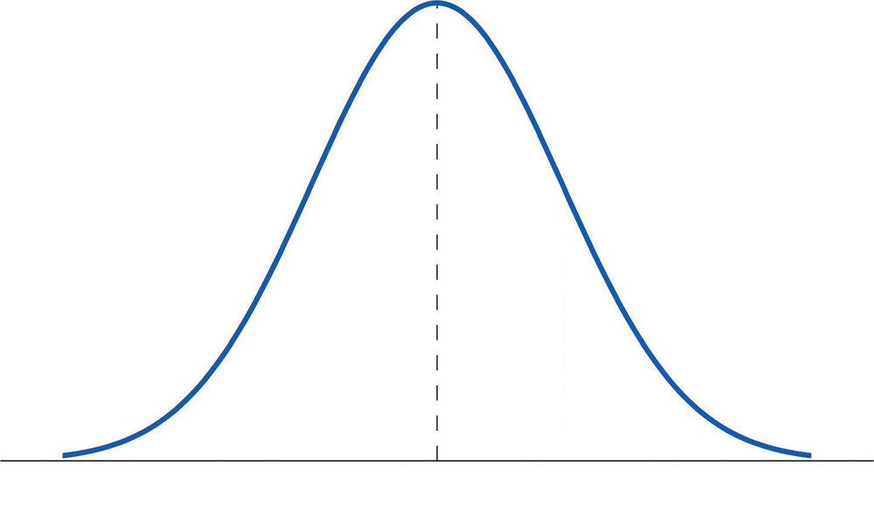





Concept Selection: Decision Criteria
Speed
Can Be Moved to Other
Sections
Accuracy
Measure Error
Can Handle Changed Engine
Parameters
Controls Lambda
MIMO
Improve Time Response
Patrick Marlatt

Slide 10
MPC Background
Final Design Chosen: LINEAR MIMO MPC
  Constraints, models, input, output are all defined by the design team
Throttle
Plant
Matlab Blockset
MPC Controller
Throttle Command
Wastegate
More accurate torque value
MAP
Wastegate Command
Torque Command
Other Inputs
Current Controller
Other Outputs
Patrick Marlatt
Notes:
Higher level

Slide 11
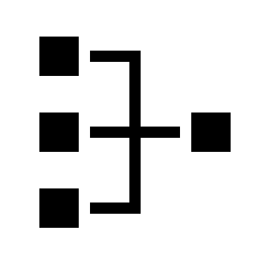
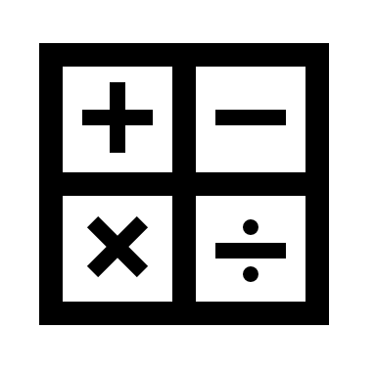


MPC Benefits
Can handle multi-input multi-output (MIMO) systems
Can handle system constraints to avoid undesired consequences
Computation requirements can be managed
Increased research, usage, and promise in automotive (and aero) industries
Patrick Marlatt
Notes:
Bullet 1: Important to use controller that can handle mimo systems well because to meet standards and stuff for cars there is a need for increased coordination among the actuators in a car
Has proven success in handling mimo systems in industry
Bullet 2: Similarly to above, this is a good thing about it for meeting new standards
Bullet 3: You can tune it and manage the computations requirement to some degree
Bullet 4: Being used a lot more in automotive and aero industries.

Slide 12



MPC Drawbacks
More complex than standard controls
Appropriate model is necessary to optimize the controller
Relatively heavy computing power required
Patrick Marlatt

Slide 13
MPC Components
Torque
Throttle
MPC Controller
Optimizer
Plant
Manifold Absolute Pressure
Wastegate
Brake Specific Fuel Consumption
Plant Model
Austin LaFever

Slide 14





MPC Terminology
Control Objective = The desired outcome of the controlled system
Controller Sample Time = Length of timesteps of prediction
Prediction Horizon = How far ahead the model predicts/simulates the future
Control Horizon = How far ahead the controller prepares changes to the model in the form of inputs
Constraints = Upper and/or lower boundaries to prevent unwanted outcomes
Austin LaFever

Slide 15
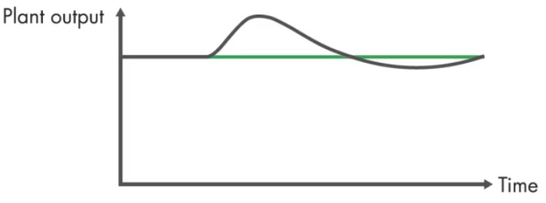
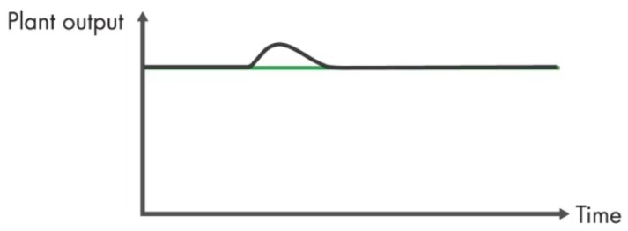
MPC Terminology: Sample Time
Sample Time: Rate at which the controller executes the control algorithm
Too Large
General Design Recommendations
y(t)
y_{final}
90%
10 to 20 time samples during 10% to 90% of rise time to steady state response
Too Small
10%
Time
Patrick Marlatt

Slide 16
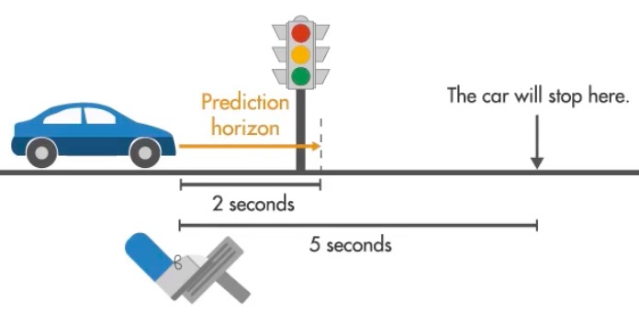
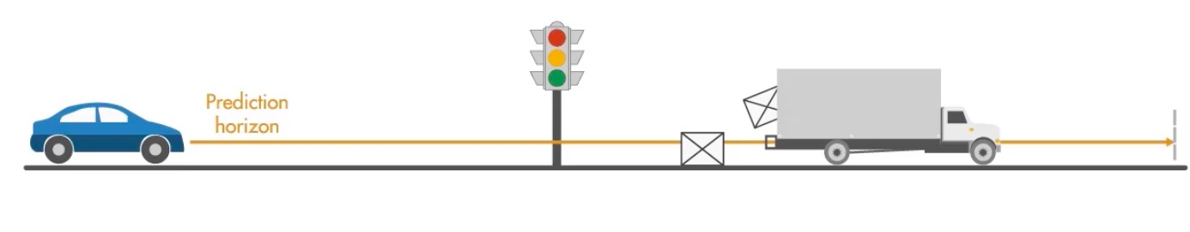
MPC Terminology: Prediction Horizon
Prediction Horizon: How far into the future the controller makes predictions
(Assuming 5 second stop time)
General Design Recommendations
Too Small
y(t)
20 to 30 time steps within prediction horizon
Too Large
Prediction Horizon
Time
Patrick Marlatt

Slide 17
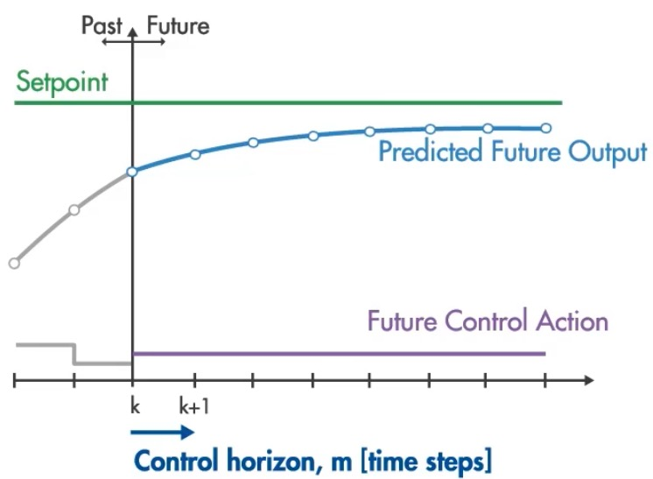
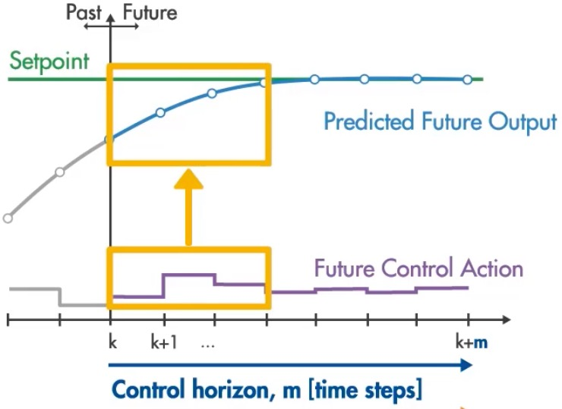
MPC Terminology: Control Horizon
Control Horizon: How far ahead the controller prepares changes to the model in the form of inputs (will be chosen by the optimizer)
Too Small
Too Large
General Design Recommendations
Control Horizon
Prediction Horizon
10% - 20% of Prediction Horizon
Patrick Marlatt

Slide 18
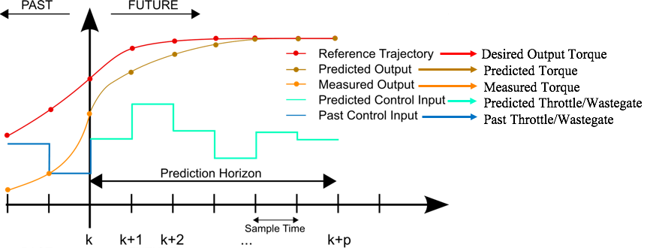
MPC Plant Visualization
Our Variables
Austin LaFever
Notes:
Reference trajectory is everything that has happened --> what the output controls torque
Measured output is what the mpc has output in the past (throttle and wastegate)
This graph is referencing the plant meaning the output of the plant is the torque and the input of the plant is the MPC's output (I.e. throttle and wastegate)

Slide 19



Modeling Approach
MPC relies on state space models
Develop a model of the engine by testing the engine by "stimulating" the inputs and measuring its responses
Use Mathworks Powertrain Blockset to generate artificial engine data
Use System Identification Toolbox to fit a state space linear model to the engine data
Design MPC controller using the model
Austin LaFever

Slide 20
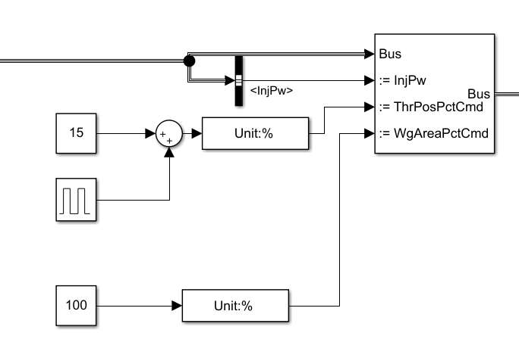

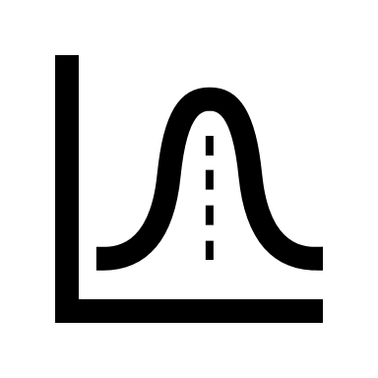

Modeling Approach
  Input variables override the current controller and will be set using a pseudo-random binary sequence (PRBS)
  The throttle data is semi-random, while the wastegate variable is set to a constant (wide open) and vice versa
  Alternating around a critical point at 3000 rpm
Austin LaFever

Slide 21

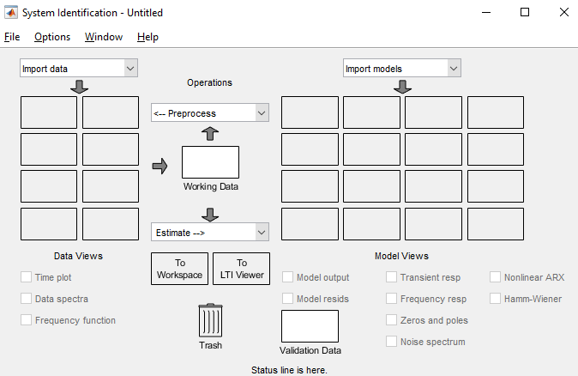

Modeling Approach
  Input and output data are recorded using data sinks
  MATLAB system identification toolbox can create a state space model using this data
Austin LaFever

Slide 22
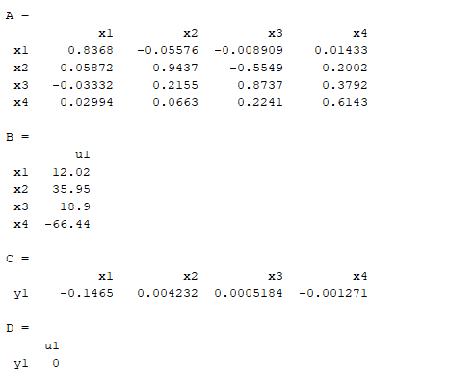

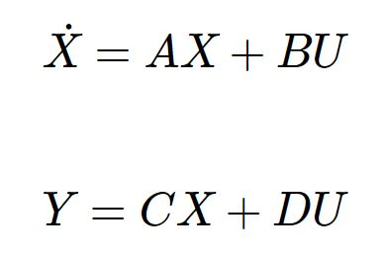


Modeling Approach
  To the right is our current state space relationship
  Will apply inputs to our state space to simulate outputs, and the compare those results to the same output from the controller
Austin LaFever

Slide 23
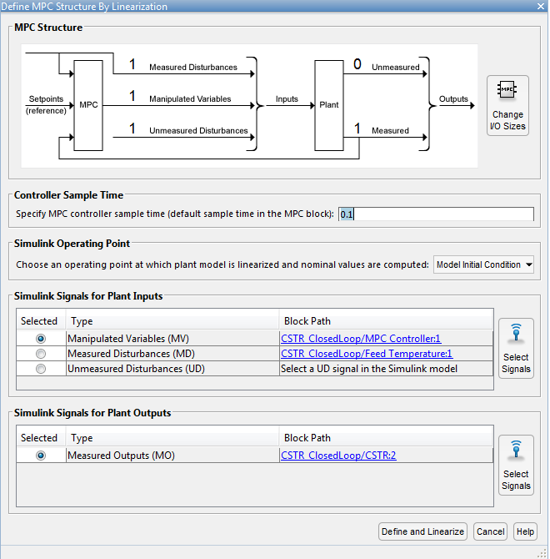

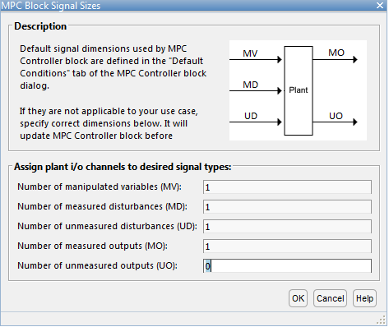
MPC Design Approach
  The MPC designer will allow us to quickly input our confirmed state space, set inputs and outputs, and make modifications as needed
Austin LaFever

Slide 24
MPC Design Approach
  Operating Points: Engine Speed and Torque
  Scheduled MPC controllers based on selected operating points
 | Low Load | Medium Load | High Load
Low Speed | MPC #1 | MPC #2 | MPC #3
Medium Speed | MPC #4 | MPC #5 | MPC #6
High Speed | MPC #7 | MPC #8 | MPC #9
Austin LaFever

Slide 25



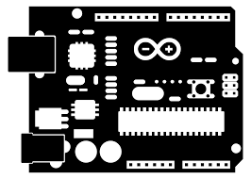
Validation
Validation done by checking the commanded torque vs. output torque graph
Two methods of validation:
Software → running the simulation and comparing error
Hardware in the loop (HIL) validation
Austin LaFever

Slide 26
Validation: Software/Controls
                Control System Analysis:
                MPC does not have pole analysis like PID, though there is some theoretical analysis
                We have been advised to take a "numerical analysis", which is just testing the system, and seeing if the numbers are accurate
                Software Analysis:
                The software model will be valid if it meets our goals of accuracy and speed once implemented
Austin LaFever
Notes:
Bullet 1: just mention it doesn’t have pole analysis “like PID which most are familiar with”

Slide 27
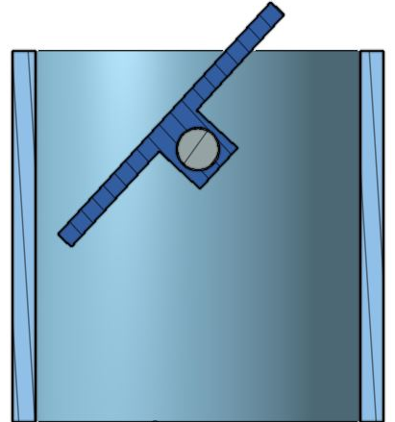
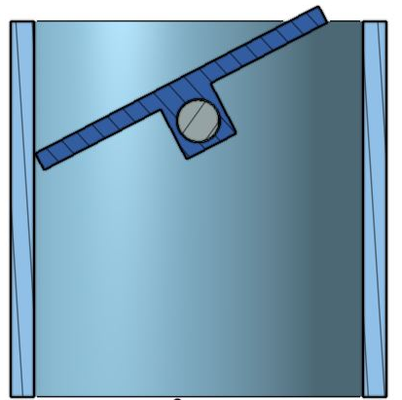
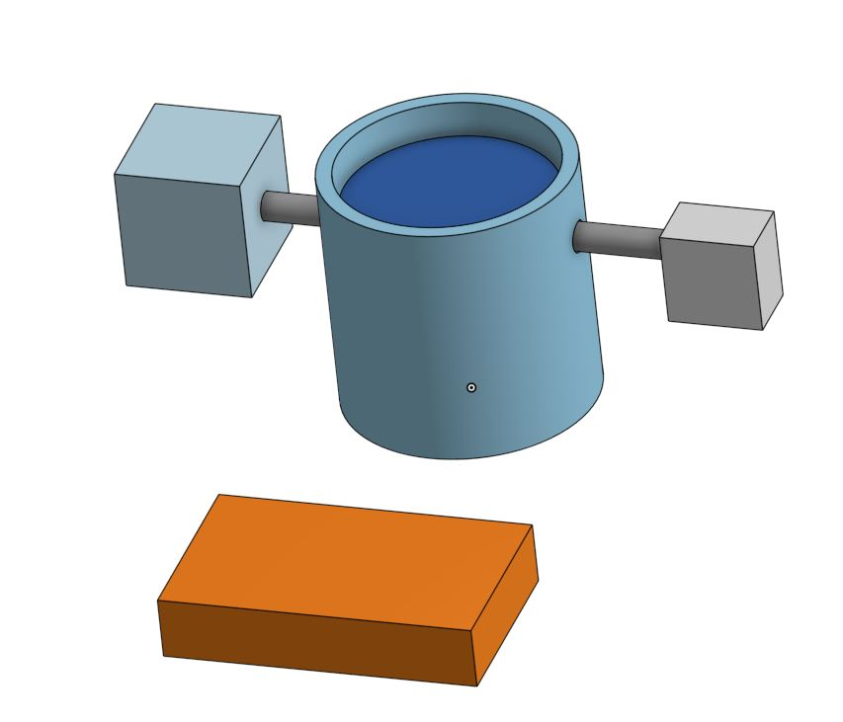

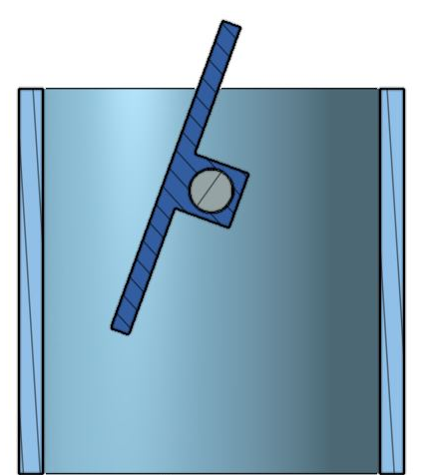
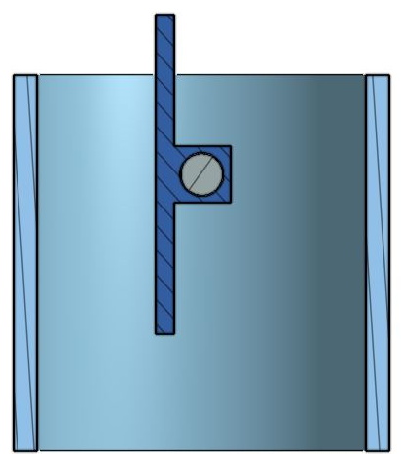
Validation: Hardware
Motor
25% (22.5°)
50% (45°)
Butterfly Valve (Throttle or Wastegate)
Angle Sensor
Data Acquisition/Motor Driver (Arduino)
75% (67.5°)
100% (90°)
Patrick Marlatt

Slide 28
Validation: Testing
                Physical:
                0°-90° rotation range
                Simulation:
                Physical throttle and wastegate movement values will override simulated movements
                Limitations:
                Air flow through the throttle will not be present
Throttle
or Wastegate
Motor
Rotary Angle Sensor
DAQ
Arduino
Patrick Marlatt

Slide 29




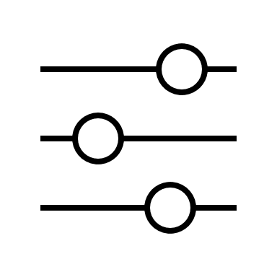
Future Work
Define constraints on system
MPC implementation
Create and test our HIL system
Choose operating points for scheduling
Patrick Marlatt

Slide 30

Conclusion
Once an accurate state space is created, MPC design can begin
Matlab includes built-in MPC mechanics and designers
HIL Testing – Arduino appears to be a usable and inexpensive options with multiple different versions to choose from
Patrick Marlatt

Slide 31
Semester Plan
 | February |  | March |  |  |  | April
Accurate Model
HIL Research
Design Review 5
MPC Throttle
MPC Wastegate
Working HIL
Final Build
Design Review 6
Validated Software w/ HIL
Senior Design Day
Patrick Marlatt

Slide 32
References
Bemporad, A., Bernardini, D., Long, R., & Verdejo, J. (2018). Model Predictive Control of Turbocharged Gasoline Engines for Mass Production. SAE Technical Paper Series. doi:10.4271/2018-01-0875
Hubicki, C. (2 September 2020). Fall 2020 Seminar #01: Trajectory Optimization and Dynamic Robotics. Youtube. https://www.yout
ube.com/watch?v=hSDMUOcJLHQ&feature=youtu.be
Woolf, P. (20 May 2020). MIMO Using Model Predictive Control. LibreTexts. https://eng.libretexts.org/Bookshelves/Industrial_
and_Systems_Engineering/Book%3A_Chemical_Process_Dynamics_and_Controls_(Woolf)/12%3A_Multiple_Input%2C_Multiple_Output_(MIMO)_Control/12.03%3A_MIMO_using_model_predictive_control
Ulusoy, M. (2020). Understanding Model Predictive Control. Mathworks. https://www.mathworks.com/videos/understanding-model-predictive-control-part-2-what-is-mpc--1528106359076.html.
(2020). Model Predictive Control. Wikipedia. https://en.wikipedia.org/wiki/Model_predictive_control#/media/File:MPC_scheme_basi
ic.svg

Slide 33
Backup Slides

Slide 34
MPC Analogy
Say that you’re driving, and your goal is to keep the car within the lane. The decisions you make to achieve this goal are very similar to how a model predictive controller works. You know your car’s characteristics: how fast it goes or how much it turns based on the control actions you take. Using this model of the car, you do simulations in your head. These give you predictions about your future trajectory based on the control actions you choose. Then you select the optimal action that drives the predicted trajectory as close as possible to the desired trajectory. This is a simplistic example to give you the general idea, but in the next video we’ll have a much more detailed discussion about how MPC works.
Austin LaFever

Slide 35
Outline
MPC
  New design approach
  MPC and why we're using it
    What are its potential issues in our case
    What are we gaining from using this --> convince the listener that we're doing the right thing
HIL:
  Diagram
    CAD? Real system? Drawing?
  Discuss outcome -> gate position to airflow to torque
  Pro/con for each solution
  Maybe we should figure out what we are using for data acquisition
  Figure out a little bit about the HIL blocks and stuff
  Might want to report something to do with processing speed (not sure if this is right term, but hopefully you know what I mean)
Software:
  Cannot use measured torque values
  Use air flow @ speed to estimate torque
  Use BSFC eqn for torque??
  Fix wastegate to open, wiggle throttle and see impact @ fixed speed
  Next wiggle wastegate to see impact
  Use system identification toolbox to create statespace

Slide 36
Semester Plan
 | January |  | February |  |  |  | March |  |  |  | April
MPC Prototyping
HIL Research
VDR 4
Working HIL
MPC Throttle
MPC Wastegate
VDR 5
Final Build
Validated Software
Senior Design Day
Patrick Marlatt

Slide 37
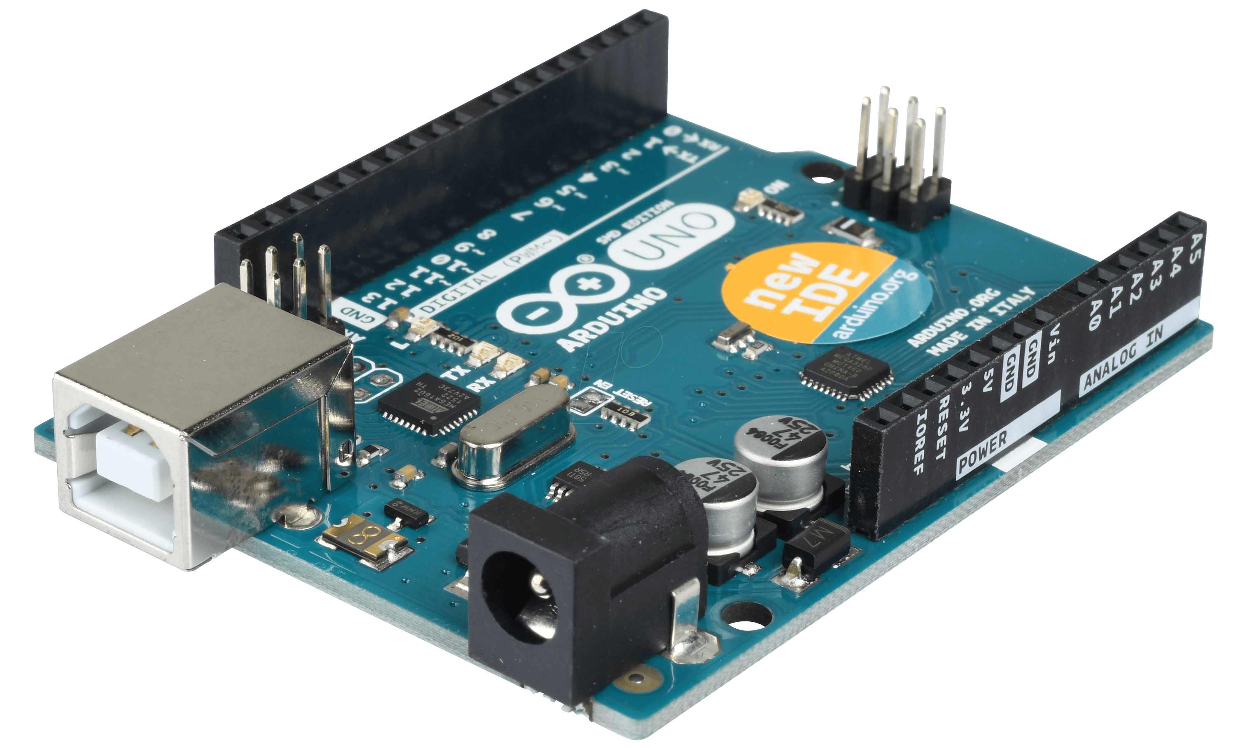
Validation: Hardware
                Arduino
                Can run Simulink projects through Arduino with add-ons
                Perform HIL testing by configuring Blockset using HIL blocks in Simulink
Patrick Marlatt
Notes:
Arduino uses Data-Streamer add-on to send data right into excel

Slide 38
Customer Needs
Question | Answer | Interpreted Need
Is it required to use model predictive control, or can we use controls that we are more familiar with, like PID, table-based, etc.? | We have been looking into MPC recently, and from our research, MPC seems to be the very best approach to solving the problem. | Use MPC control for project approach.
What will we be using as inputs and outputs to our control system? | A good start place to get familiar with simulink and the control system is the wastegate and throttle. If you start there, we can see what else you can add. | The control system implements the throttle and wastegate. Additional factors can be included.
How would we know if our control system is accurate? | Running the program produces a graph of desired intake vs actual intake. The closer the two lineup, the better your system. | The control system only demands what the system can provide. The blockset will produce a graph to ensure accuracy.
What is the main goal of this project? | The main goal is to integrate and simulate an MPC controller block in the powertrain block control set. The MPC should control the throttle and wastegate to get the ideal boost for the system. The new MPC controller designed by the group will replace the existing control system. | Create an MPC controller that will control the throttle and wastegate inputs to replace the existing outdated controller.

Slide 39
What is a good place to get started?​​ ​​ ​​ | Play around with the power train blockset. Go through it, see how it all works; change the inputs and see what happens. ​​ ​​ ​​ | ​​ ​​
What can we do while we wait for the blockset?​​ ​​ ​​ | There are apps on the market to record your car’s information [ on the throttle and wastegate], that information will help get started​​ ​​ ​​ | Our model results can be compared to physical systems​​ ​​ ​​
What is the best way to simulate our controller within the system?​​ ​​ ​​ | The powertrain blockset and Simulink can be used to simulate the system. We will look into getting the group access to GT Power as it has more specific engine models and GT Power is used the most in the industry for these types of simulations.​​ ​​ ​​ | Use powertrain blockset and Simulink for simulations and perhaps GT Power later on in the project. ​​ ​​ ​​ ​​

Slide 40
Functional Decomposition
MIMO Control System
Air Flow Control
Receives Multiple Inputs
Receives Throttle Position Command
Receives Wastegate Position Command
Returns Multiple Outputs
Returns Throttle Position
Returns Wastegate Position
Handles Differing Parameters
Operates for Varying Displacements
Operates for Varying Desired Powers
Operates for Varying Number of Cylinders
Integration
Works in conjunction with current feed forward controls
Estimation Improvement
Align Output Torque with Desired
Drive Lambda ~ 1
Improve Time Response
Measure Error

Slide 41
Functional Decomposition: Cross Reference Table
Function | Air Flow Control | Integration | Estimation Improvement
Receives Multiple Inputs | x
Receives Throttle Position Command | x
Receives Wastegate Position Command | x
Returns Multiple Outputs | x
Returns Throttle Position | x
Returns Wastegate Position
Handles Differing Parameters | x | x
Operates for Varying Displacements | x | x
Operates for Varying Desired Powers | x | x
Operates for Varying Number of Cylinders | x | x
Works in conjunction with Current Feeed Forward Controls | x | x
Align Output Torque with Desired | x |  | x
Measure Error |  |  | x
Drive Lambda ~ 1 | x |  | x
Improves Time Response | x |  | x

Slide 42
Concept Generation: Morphological Chart
Input/Output​ | Controller​ Type​ | Location in​ Blockset​ | Program​ (for MPC)​ | Linearize​ (for non-MPC)​
SISO​ | MPC​ | Before Table​ | Linear​ | yes​
MIMO​ | PID​ | After Table​ | Quadratic​
SIMO​ | Feed Forward​ | Replace Tables​ | Nonlinear​ | no​
MISO​

Slide 43
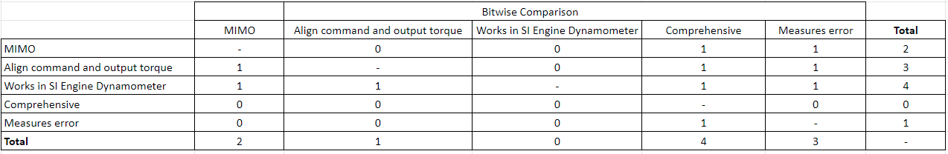
Concept Selection: Piecewise Bitwise Comparison

Slide 44
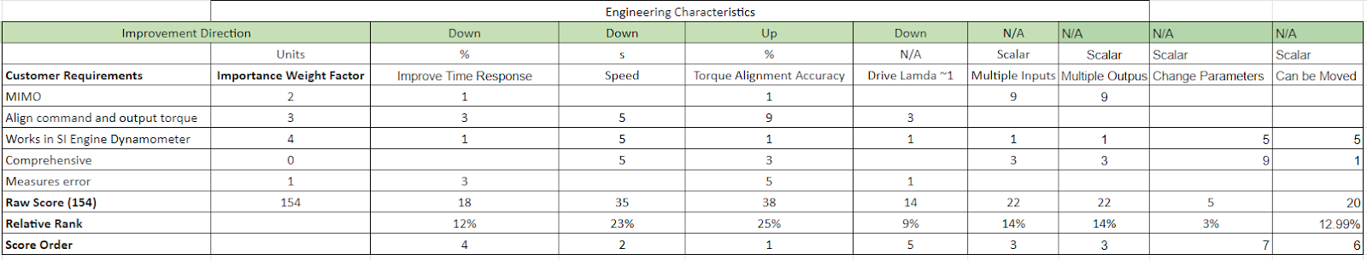
Concept Selection: House of Quality

Slide 45
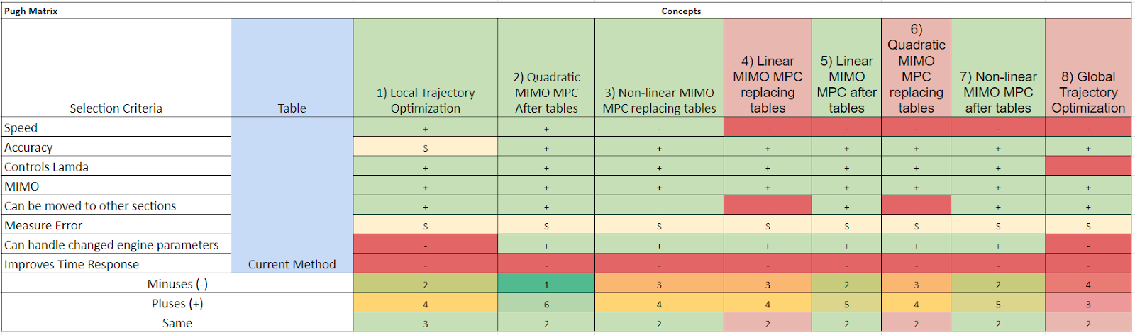
Concept Selection: Pugh Matrix 1

Slide 46
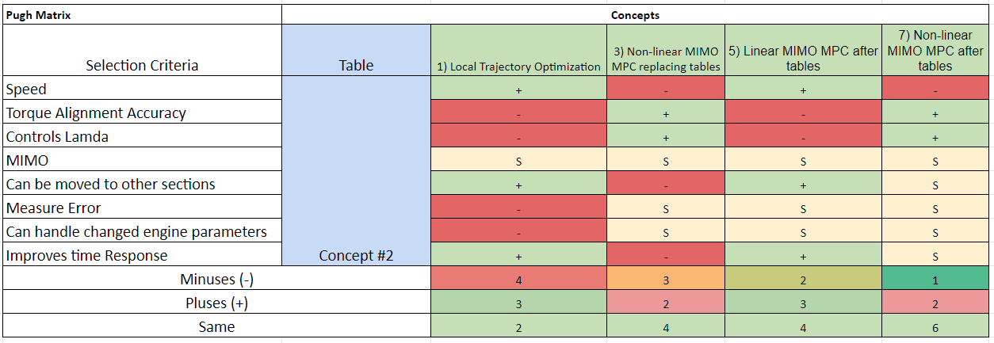
Concept Selection: Pugh Matrix 2

Slide 47
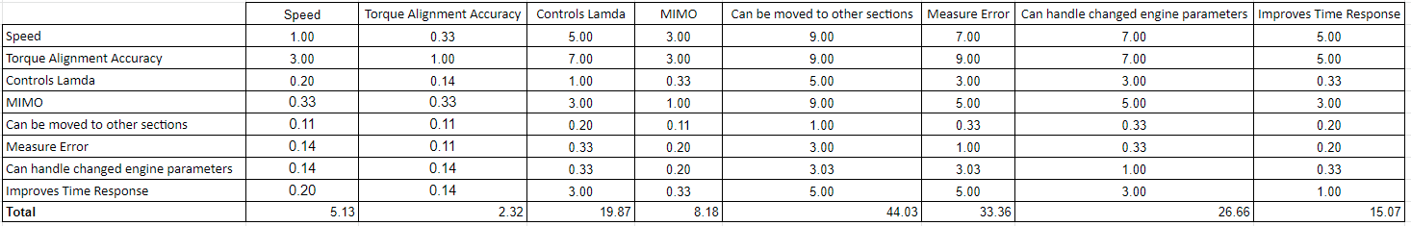
Concept Selection: AHP Criteria Comparison

Slide 48
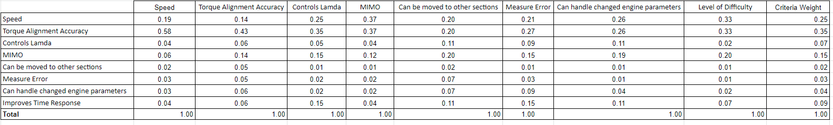
Concept Selection: AHP Normalized Criteria Comparison

Slide 49
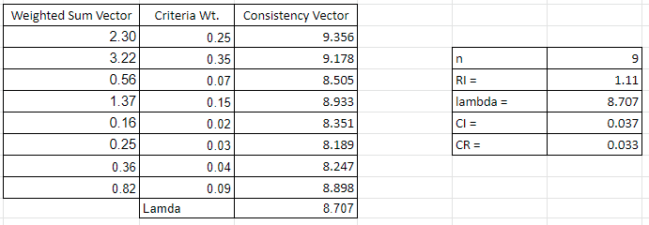
Concept Selection: AHP Final Validation

Slide 50
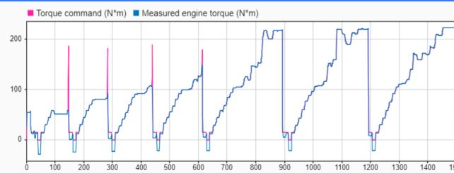

Dynamometer Torque Response

Slide 51
MPC Plant Visualization
Our Variables
Jonathan Wozny
Notes:
Reference trajectory is everything that has happened --> what the output controls torque
Measured output is what the mpc has output in the past (throttle and wastegate)
This graph is referencing the plant meaning the output of the plant is the torque and the input of the plant is the MPC's output (I.e. throttle and wastegate)

Slide 52
Motivation
Jonathan Wozny
Notes:
We are starting the process of modernizing their engine control unit with multi-input multi-output → their control setup is pretty outdated and used only single input single output

